Slide 1

Ames Iowa Housing Price Prediction: What to buy & How to Sell
James Welch

Slide 2
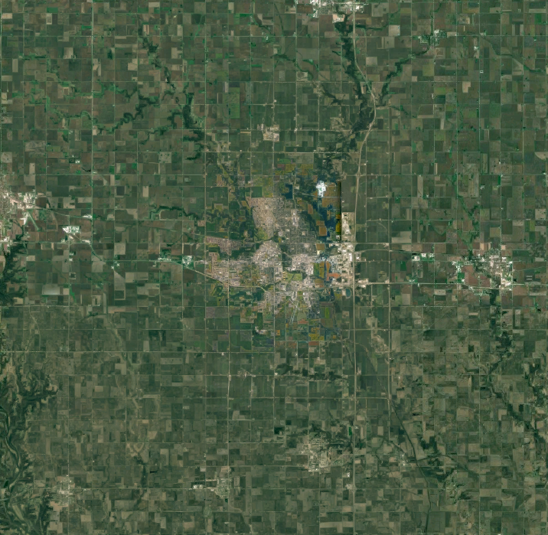
Ames Iowa
Modest Midwest City
Iowa State University
Housing Data
Notes:
Ames was founded in the 1860s and spent its early days as a stop along the transcontinental railroad.
This is a fairly small city at about 70,000 people and is surrounded by farmland, as you might expect in iowa.
Half the cities residents are students due to the presence of Iowa State university, Not to be confused with the buckeyes.
The university acts as an anchor for the community, boulsters the economy, and acts as a draw for other companies such as
3M (adhesives) and Ball (cans/jars)
Most importantly for us, Dean De Cock obtained and developed the Ames Housing Dataset. He aimed to create a resourse similar to the boston housing dataset and was able to obtain data from the city of Ames.
From 2006 to 2010

Slide 3




The Data
Land
House
Lot Area
Street & Alleys
Neighborhood
Nearby Features
Baths
Square Footage
Basement
Garage
House Style
House Type
Additional Features
Amenities
Pool Area & Quality
Fireplaces
Porches
Paved Driveway
Month & Year Sold
Sale Type & Condition
Miscellaneous Feature & Price

Slide 4
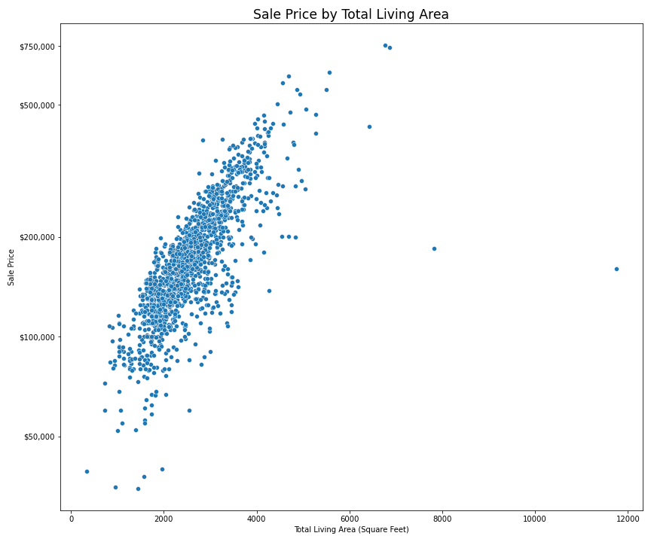
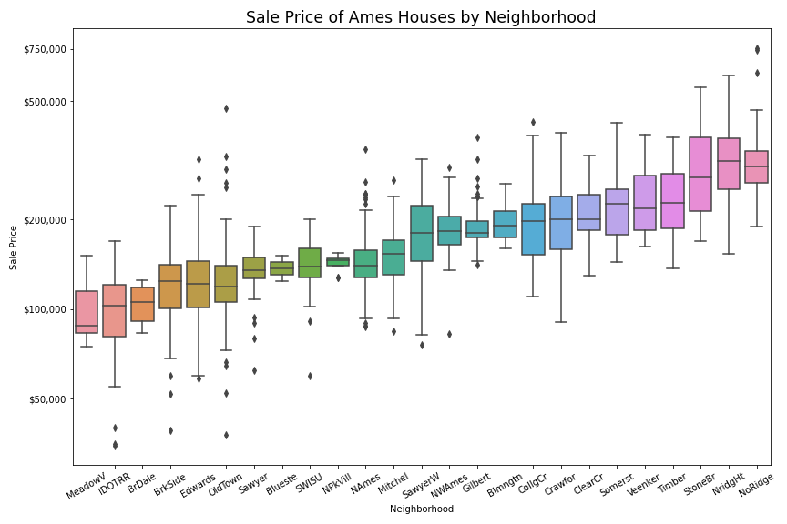
Gut Check

Slide 5
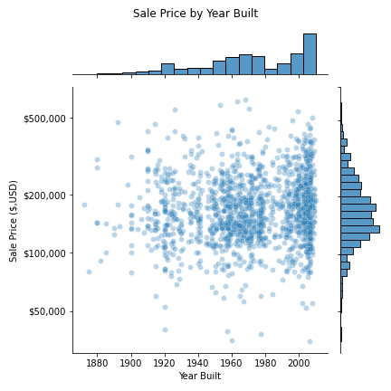
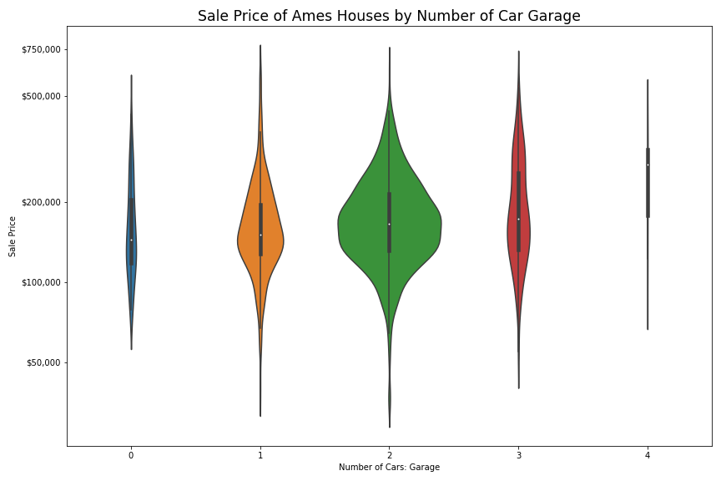
Gut Check

Slide 6
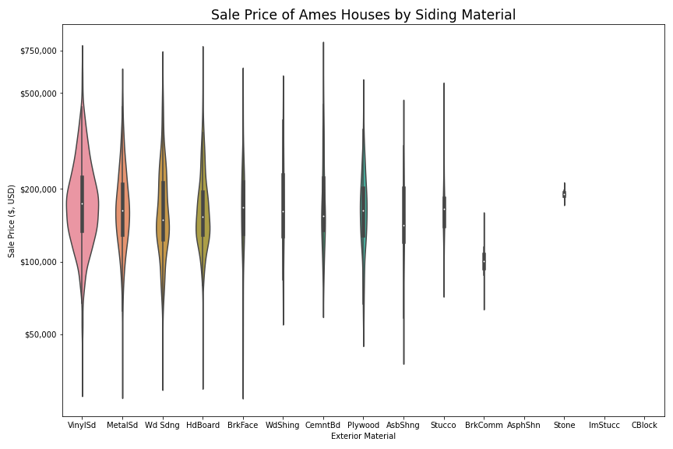
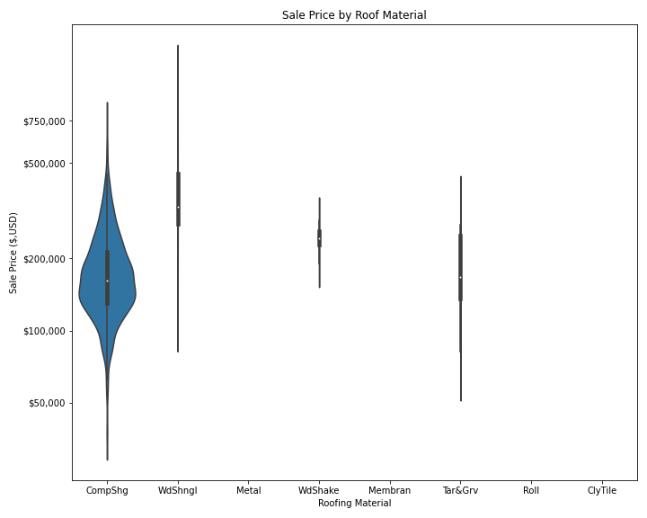
To Judge a House by it’s Materials

Slide 7
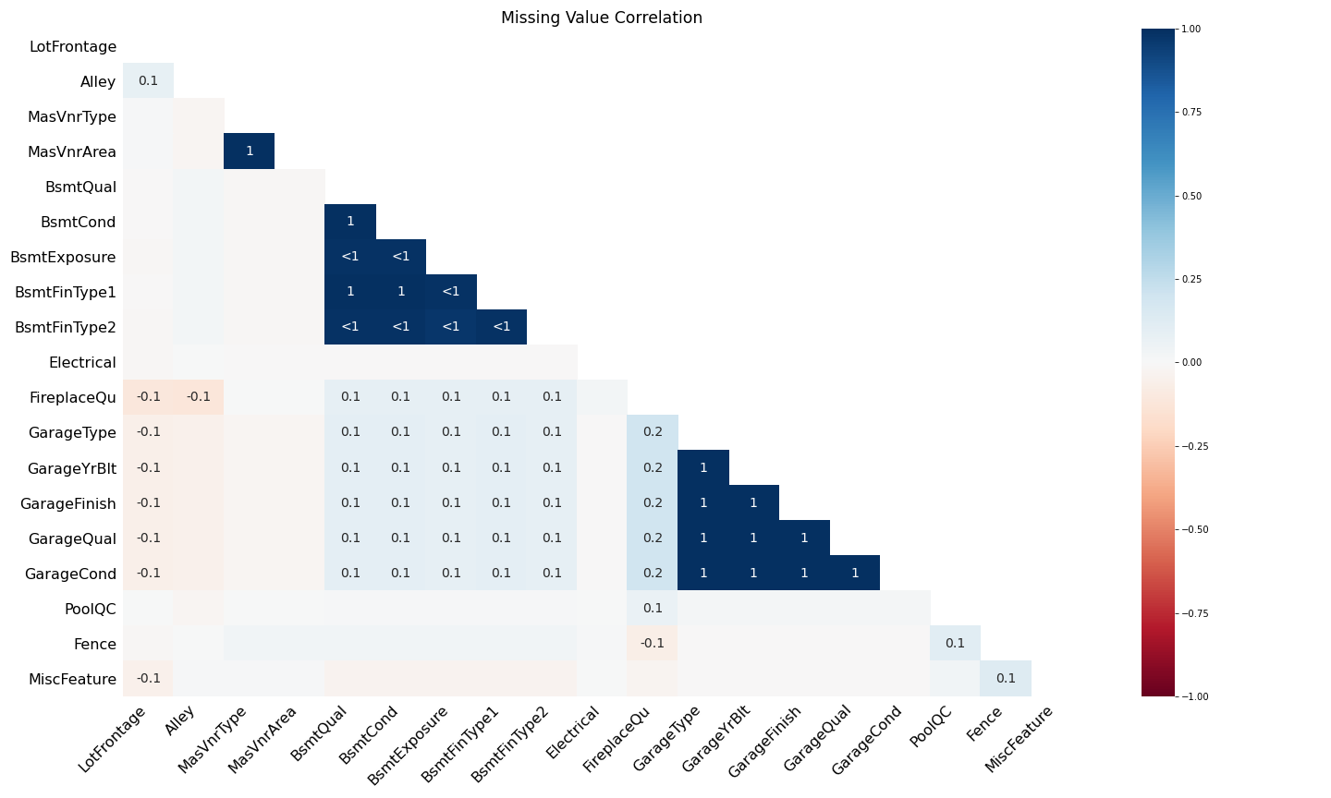
Missing* Values
Garage & Basement features so inter-group correlation
Other features show minor correlations.
However, we need to take the data key into account.

Slide 8
Actual Missing Values
Lot Frontage
N = 259
Masonry Veneer Type
N = 8
Electrical
N = 1
* Relative scale

Slide 9
Null Imputation & Data Cleaning
Missingness:
Intentional missingness, NA’s imputed to “None” or 0.
Actual missing values imputed by columns:
Electrical: Mode
Masonry Veneer Type : “None”
Lot Frontage: Neighborhood & Lot configuration
Cleaning:
Categories stored as numbers
Standardized ordinals
Misspelled values in Exterior Material

Slide 10
Feature Engineering
Pivoted:
Porches: Porch Type & Total Porch SF.
Basement Type & Square Footage were unpivoted
Boolean Flags
Has Pool
Remodeled
Recent Taste (remodel within 6 years of sale)
Area values:
Total house area
Total Finished SF (subtracting unfinished area)
Number of Floors
Total Baths
Yard Area

Slide 11
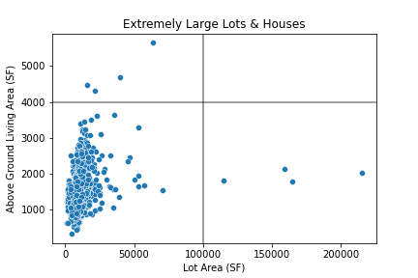
Outliers
The curator of the dataset suggests removal of houses with a GrLivArea greater than 4000.
LotArea also contains several outliers with z-scroes greater than 4.
Only one sale didn’t have standard Utilities
2.3 acres
Notes:
Original Paper suggests removing points with a Above Ground Living Area greater than 4000, which we saw before.

Slide 12
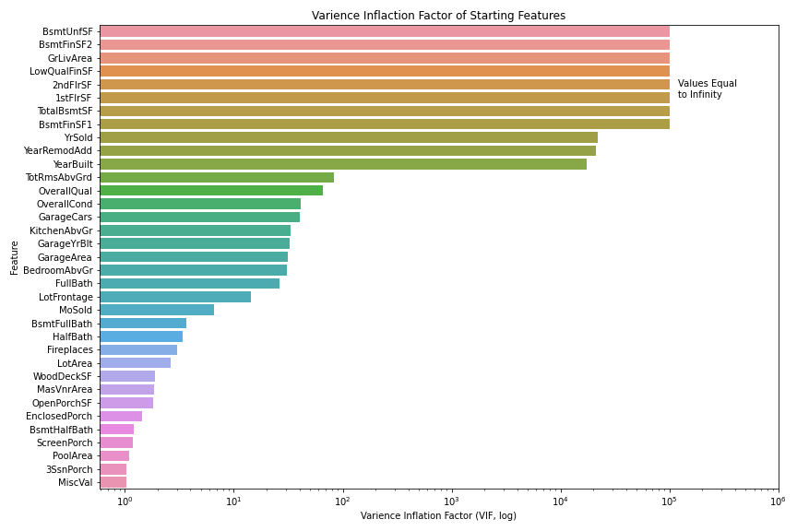
Multi-collinearity
VIF scores how ‘explainable’ any feature is based on other features.
Area variables are prone to high VIFs.
High VIFs of important variables requires feature selection

Slide 13
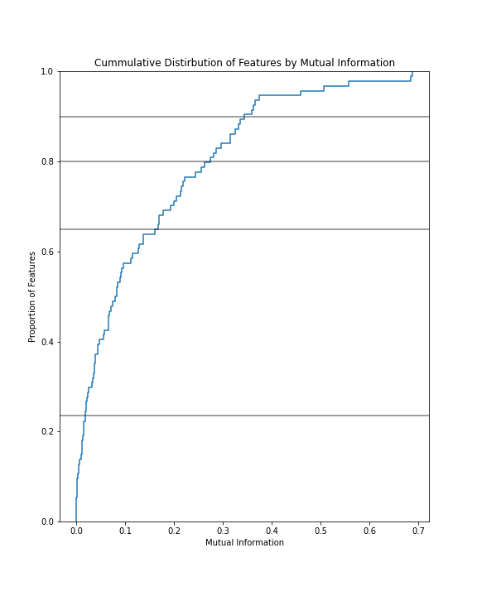
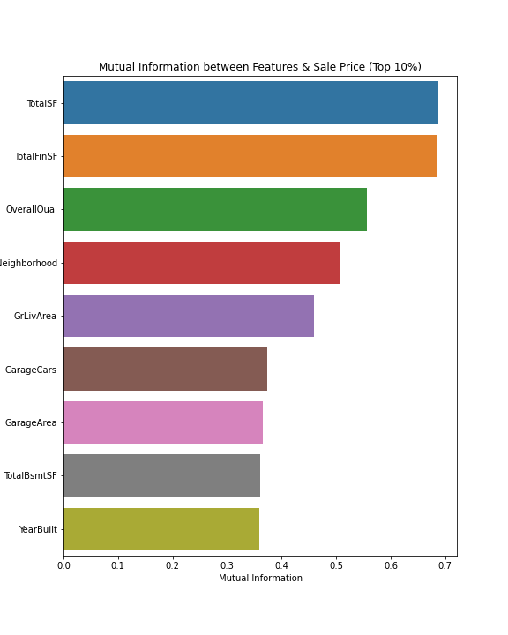
Feature Selection via Mutual Information
Top 10%
Top 20%
Top 35%
Non-zero MI
All Features

Slide 14
Some Features Contain Information

Slide 15
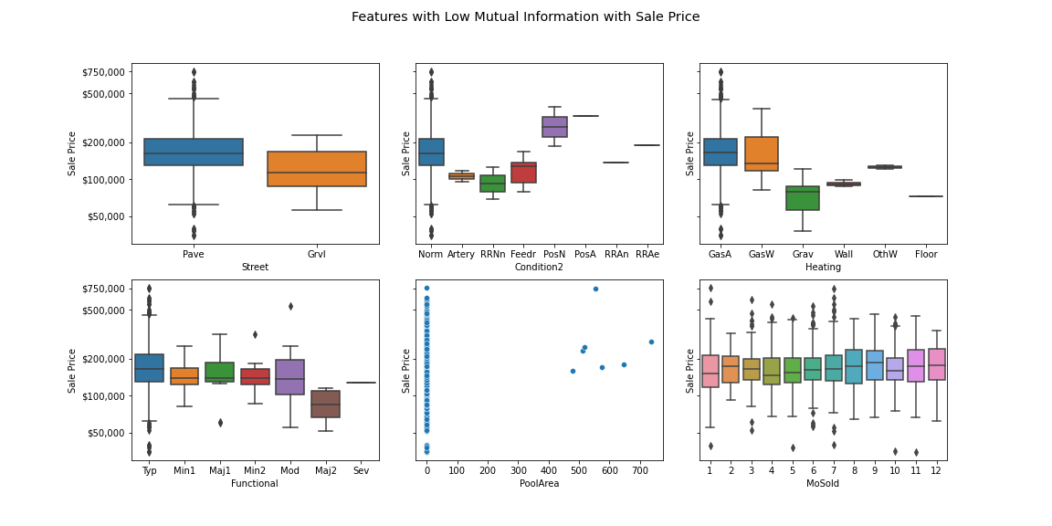
Others, less so

Slide 16
So Far
Feature Selection
Model Training
Multi-Collinearity
Outlier Removal
Imputation & Cleaning
Feature Engineering

Slide 17
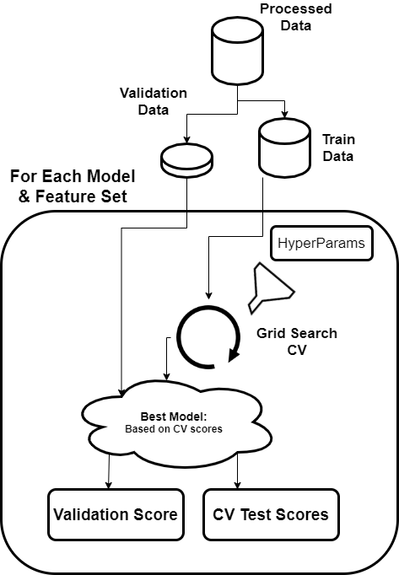
Model Training & Tuning
Feature Sets:
Top 10%
Top 20%
35%
Non-zero Mutual Info
All features
Models:
Ridge, Lasso, Elastic Net
SVR
RandomForest, Gradient Boost, XGBoost

Slide 18
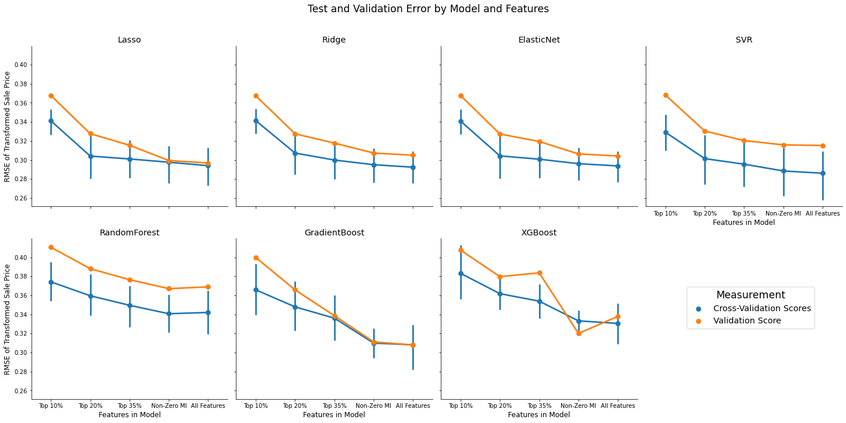
RMSE improves with More Features

Slide 19
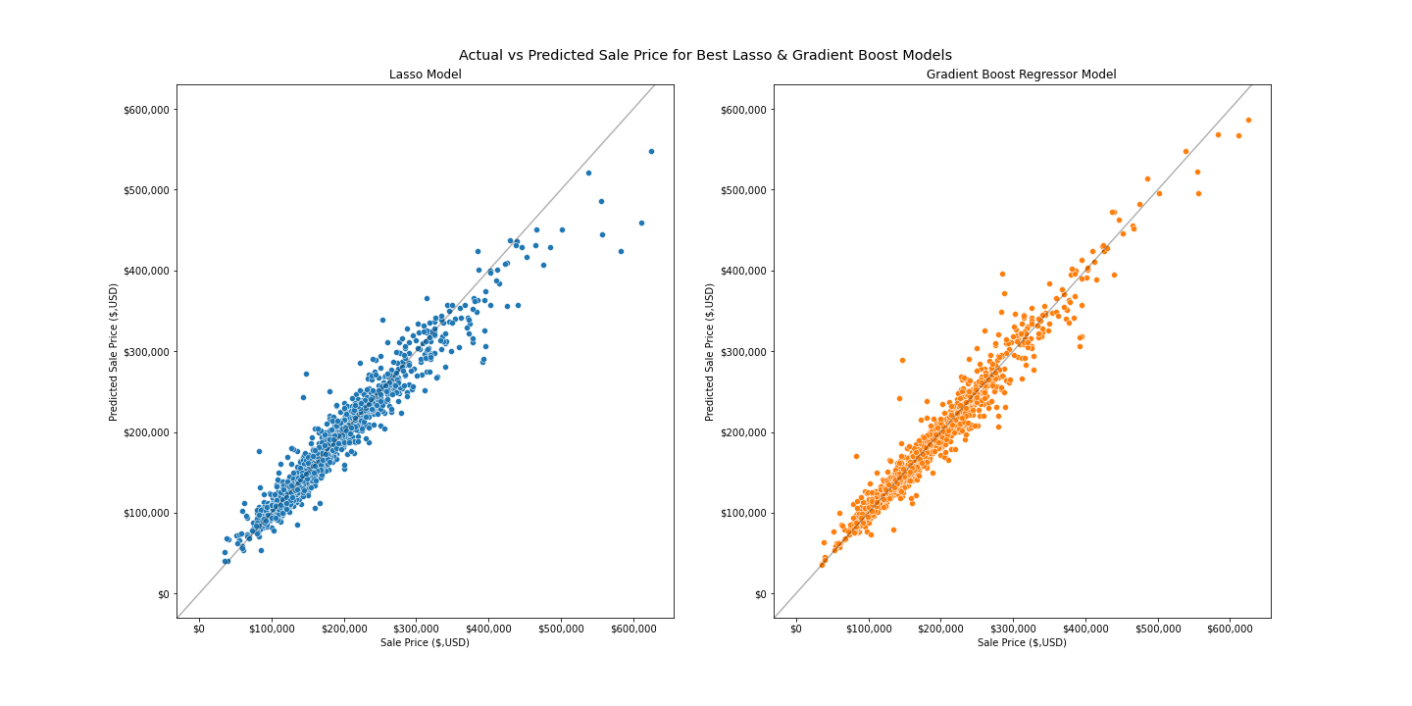
Models Poorly Predict Expensive Homes
Training RMSE:
Lasso: $18,700
Gradient Boost: $11,400
Validation RMSE:
Lasso: $19,300
Gradient Boost: $21,300
Kaggle Score:
Lasso : 0.21
Gradient Boost: 0.13

Slide 20
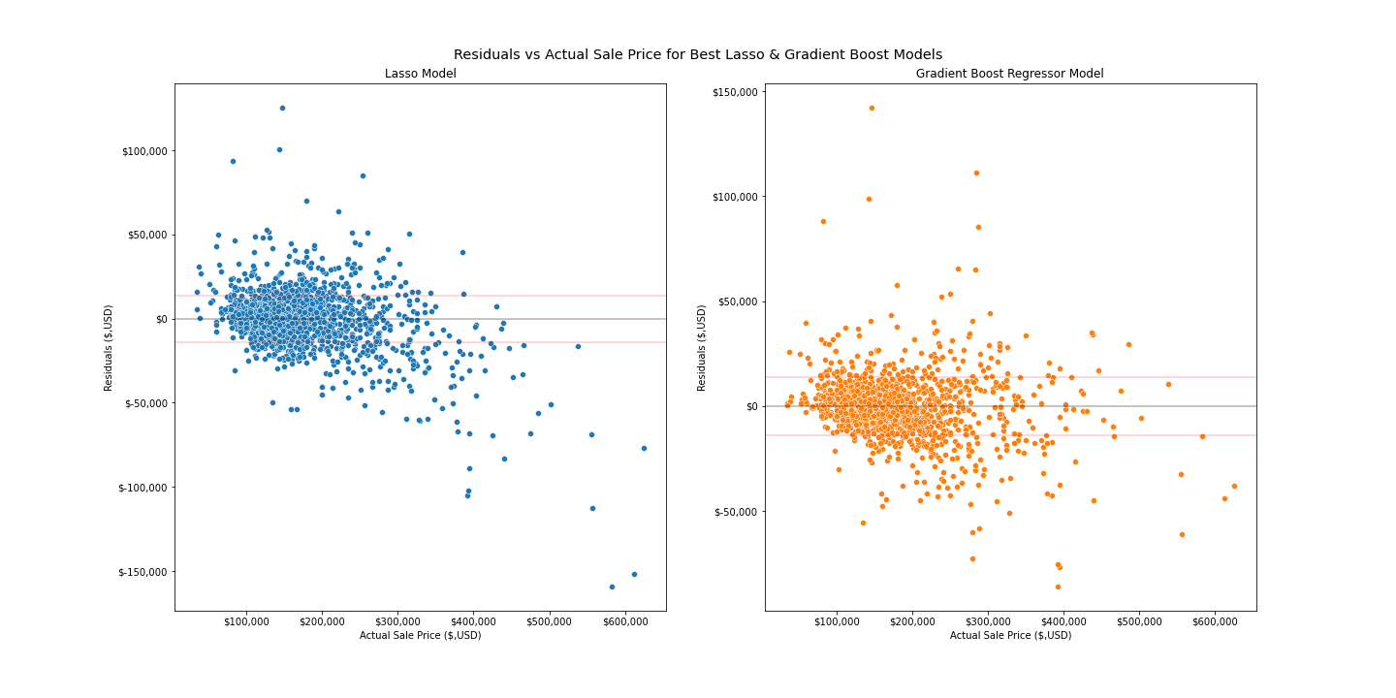
Model Residuals
Validation MAE:
Lasso: $13,900
Gradient Boost: $14,000
Validation MAPE:
Lasso: 8%
Gradient Boost: 8%

Slide 22
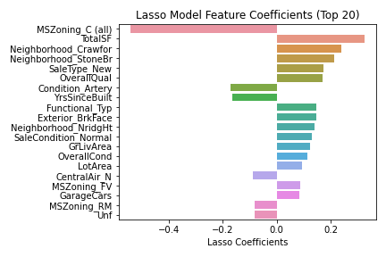
Lasso Feature Importance
Lasso coefficients reflect the incremental increase between the normalized input & normalized target.
Within-feature comparisons are more useful.

Slide 23
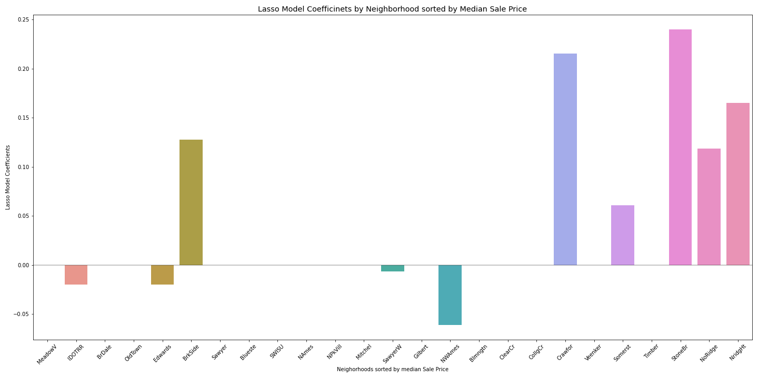
Neighborhoods

Slide 24
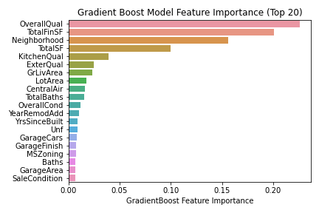
Gradient Boost Feature Importance
Feature importance's are intuitive but lack interpretable coefficients.
More analysis needed to understand the effect of each feature.

Slide 26
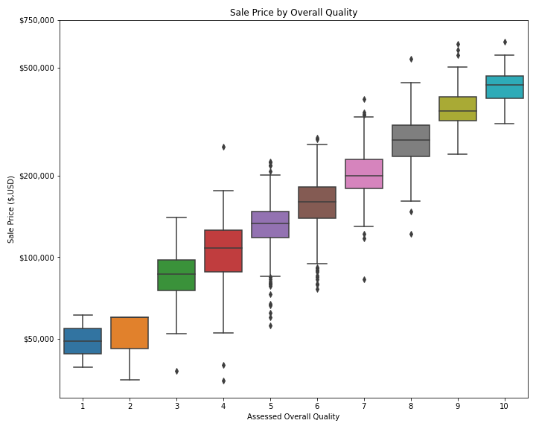
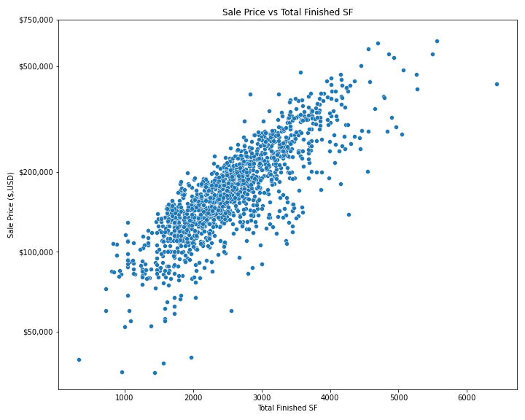
Quality
Total Finished SF = Total SF – Low Quality SF

Slide 27
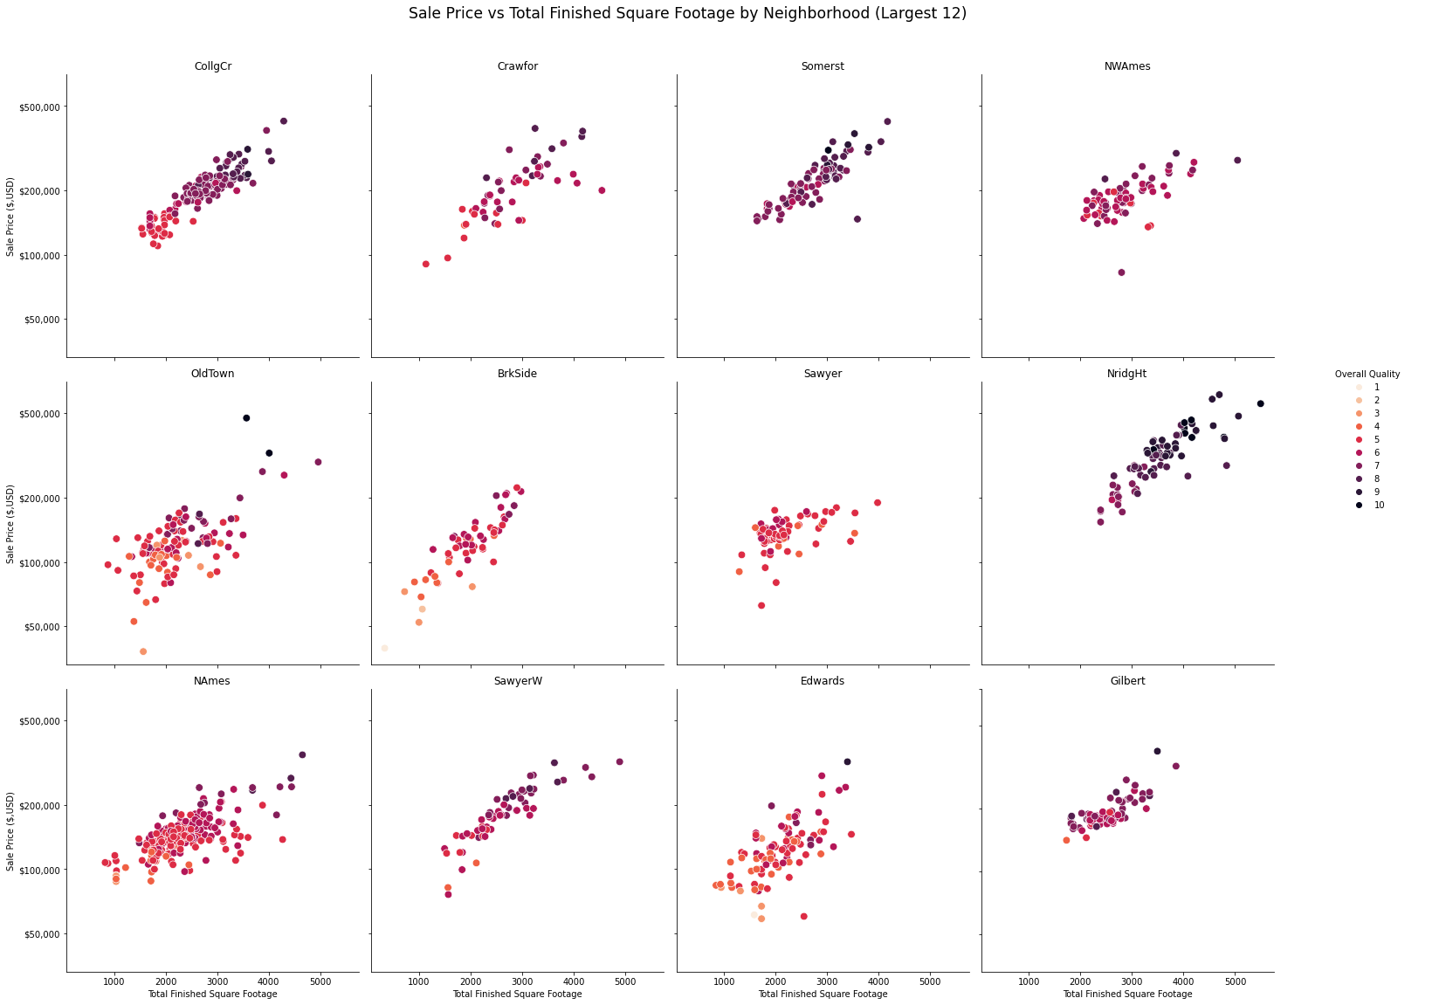
Bringing it together
We might expect and know neighborhood, size, and quality influence price.
However, these are not truly independent variables.

Slide 28
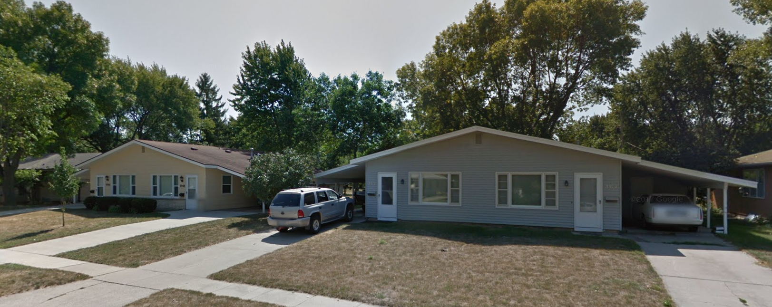



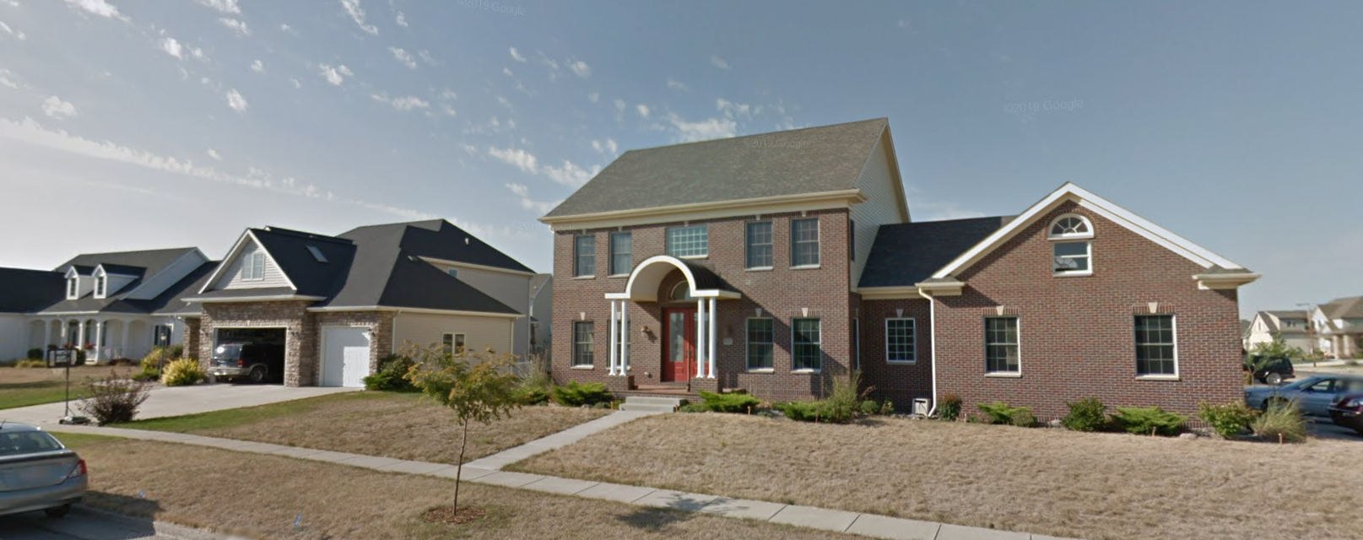


A Real difference
Sawyer
Northridge heights
Sawyer
Lot Area
10,500 SF
10,800 SF
Finish SF
2,200
3,500
Northridge heights
Quality
5.0
8.3
Year Built
1978
2006
Sale Price
$135,000
$300,000

Slide 29



What to keep in mind
Purchasing:
Total SF (Especially Finished)
Neighborhood
Lot Size
Garage
Zoning
Selling:
Overall Quality & Condition
Kitchen Quality
Central Air
Recent Remodeling
Unimportant:
Roofing Materials
Lot Shape
Building Type
Fence

Slide 30
Next Steps
Land & House
Process
Better Model
Notes:
Better feature engingeering

Slide 31
Conclusion
Housing transactions are expensive & complicated.
Our model predicts the housing price with an average error of only 8%.
However likely lower for mid-priced homes.
The appearance and size of a home are some of its most important features. Some features can be expensive to update, others as cheap as a new stove.
The worst home in the best neighborhood.
Cover Photo by Breno Assis on Unsplash

Slide 32

Thank you
Questions?

